Slide 1

Robot Framework Playback Session
Date : 10/05/2023

Slide 2

Agenda
ROBOT Framework Overview
Automation in Nuuday

Slide 3
What is Robot Framework?
Robot Framework is a generic open-source automation framework. It can be used for test automation and robotic process automation (RPA).
It is a keyword-driven testing framework that uses tabular test data syntax.
Robot Framework has an easy syntax, utilizing human-readable keywords. It’s capabilities can be extended by libraries implemented with Python, Java or many other programming languages.

Slide 4
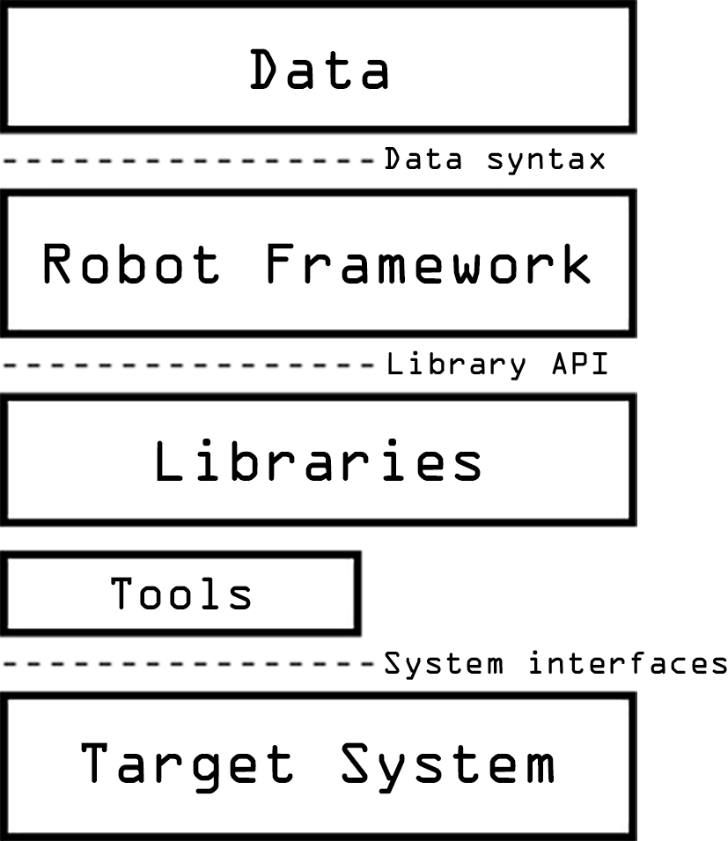
High-level Architecture
When a test is run for the first time, the framework parses the test data.
When Robot Framework is started, it processes the data, executes test cases and generates logs and reports.
The core framework does not know anything about the target under test, and the interaction with it is handled by libraries.
Libraries can either use application interfaces directly or use lower level test tools as drivers.

Slide 5
Features of Robot framework
Tabular format for test cases
Robot framework comes with a simple tabular format where the test cases are written using keywords. It is easy for a new developer to understand and write test cases.
Keywords
Robot framework comes with built-in keywords available with robot framework, keywords available from the libraries like Selenium Library (open browser, close browser, maximize browser, etc.). We can also create user-defined keywords, which are a combination of other user-defined keywords or built-in or library keywords. We can also pass arguments to those keywords, which make the user-defined keywords like functions that can be reused.
Libraries
Robot framework has support for a lot of external libraries like SeleniumLibrary, Database Library, FTP Library and http library. SeleniumLibrary is mostly used as it helps to interact with the browsers and helps with web application and UI testing. Robot framework also has its own built-in libraries for strings, date, numbers etc.
Test Case Tagging
Robot framework allows to tag test-cases so that we can either run the tags test-cases or skip the tagged testcases. Tagging helps when we want to run only a group of test cases or skip them.
Reports and Logs
Robot framework provides all the details of test suite, test case execution in the form of report and logs. All the execution details of the test case are available in the log file. The details like whether the test case has failed or passed, time taken for execution, steps followed to run the test case are provided.

Slide 6
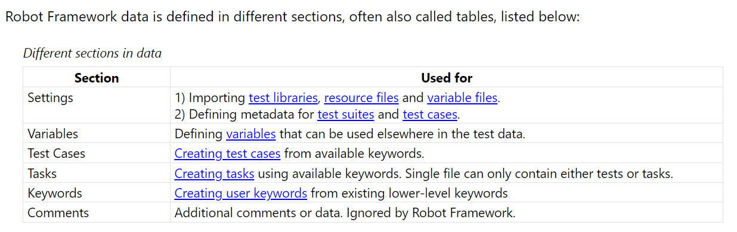
Test Data

Slide 7
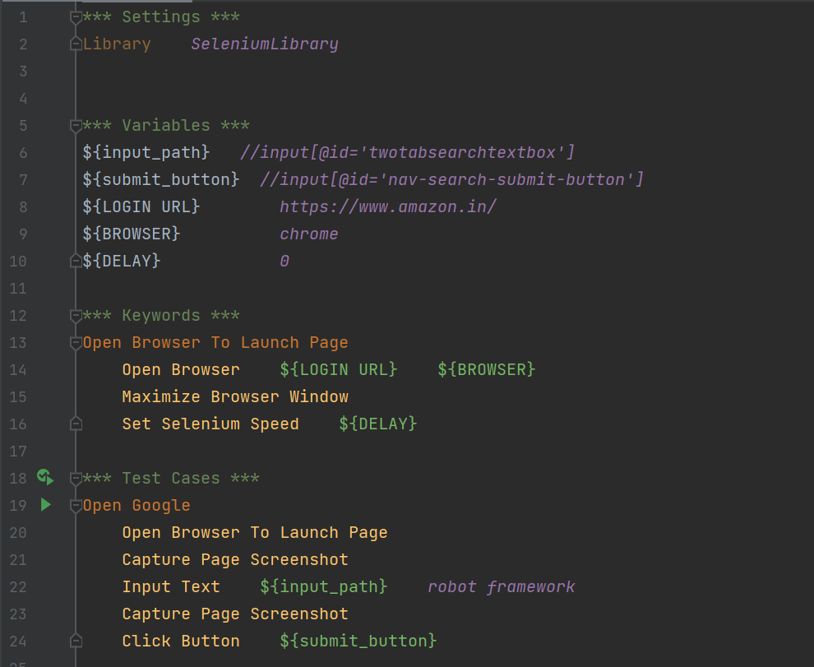
Robot Framework Design

Slide 8
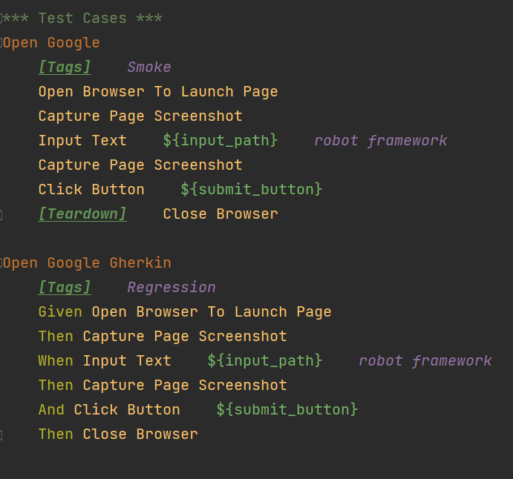
TAGGING
Tags are labels that you can assign to your test cases, test suites, or individual keywords in Robot Framework. You can use tags to group related test cases, to indicate the priority or status of a test case, to mark test cases that require special setup or teardown, or to exclude test cases from execution.

Slide 9
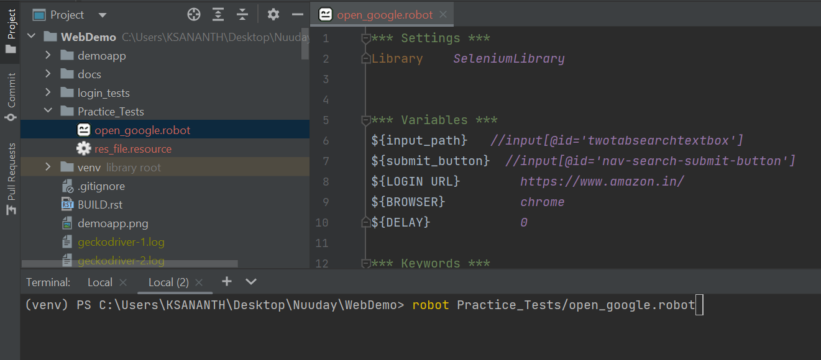
RUNNING A ROBOT TEST:
Robot tests can be triggered from command line. The easiest way to execute Robot Framework is using the `robot` command.

Slide 10
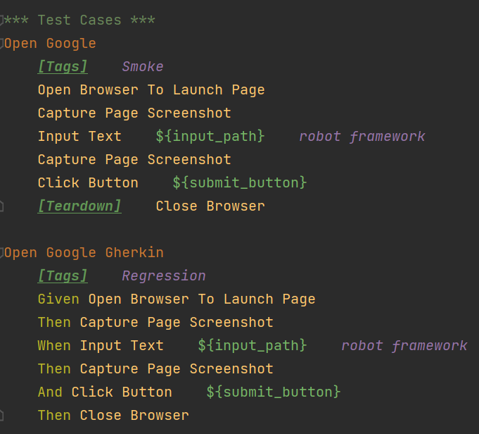
Running a test with tags
Test cases and suites annotated with tags can be executed by selecting tags to be included or excluded using ‘—include’ or ‘—exclude’ commands, respectively.

Slide 11
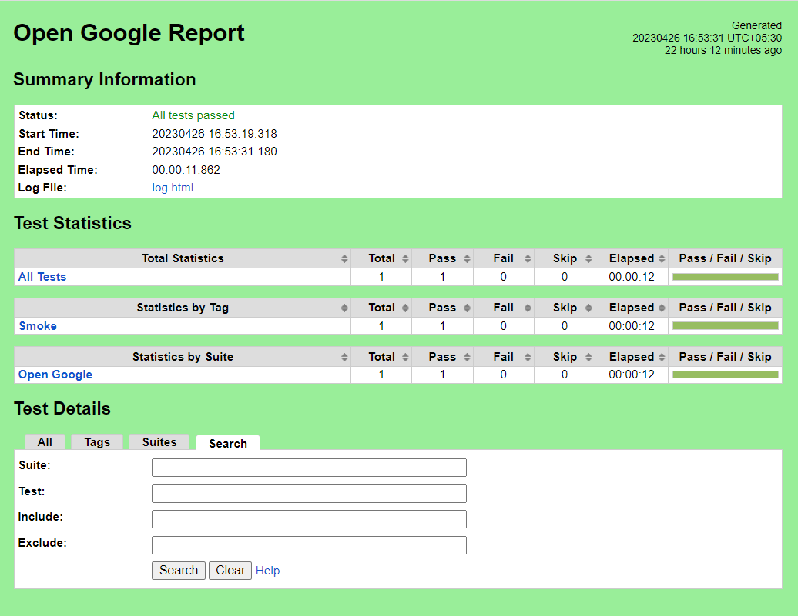
Reports
Robot framework provides all the details of test suite, test case execution in the form of report and logs. All the execution details of the test case are available in the log file. The details like whether the test case has failed or passed, time taken for execution, steps followed to run the test case are provided.

Slide 12
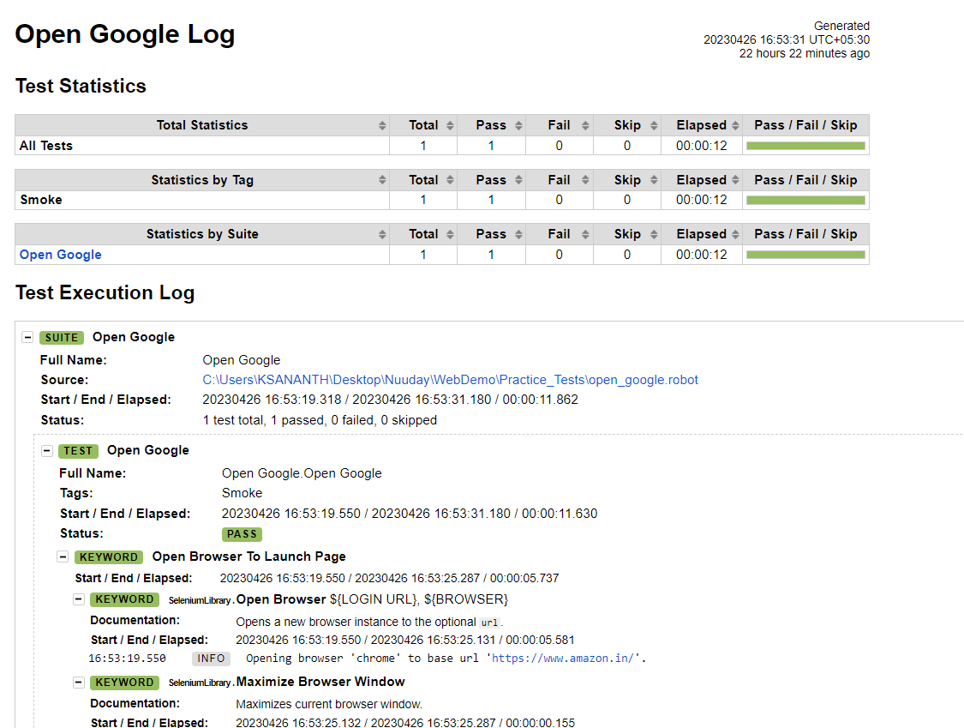
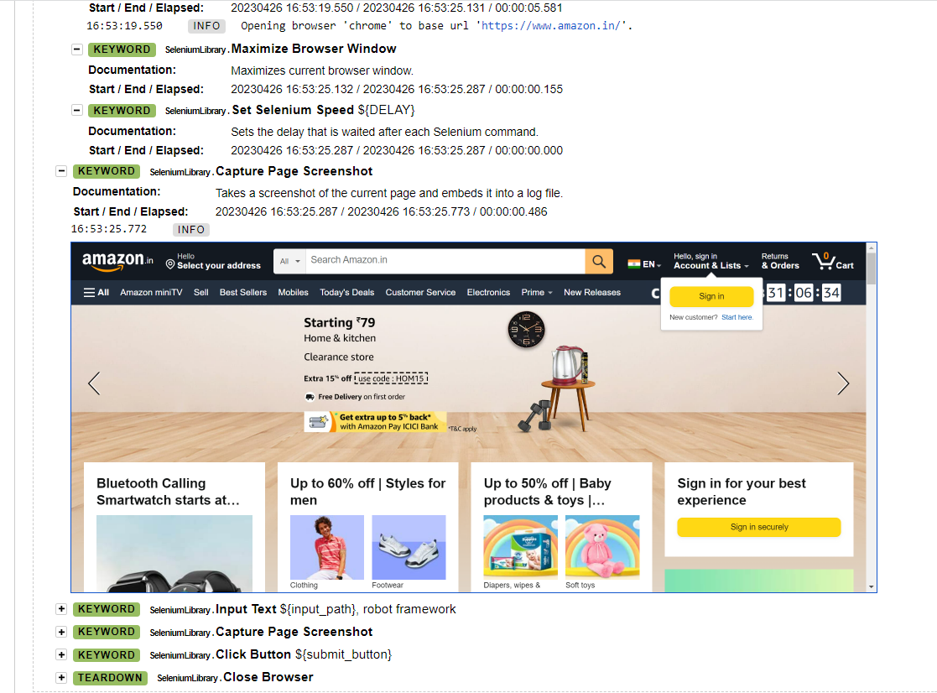
Contd…

Slide 13
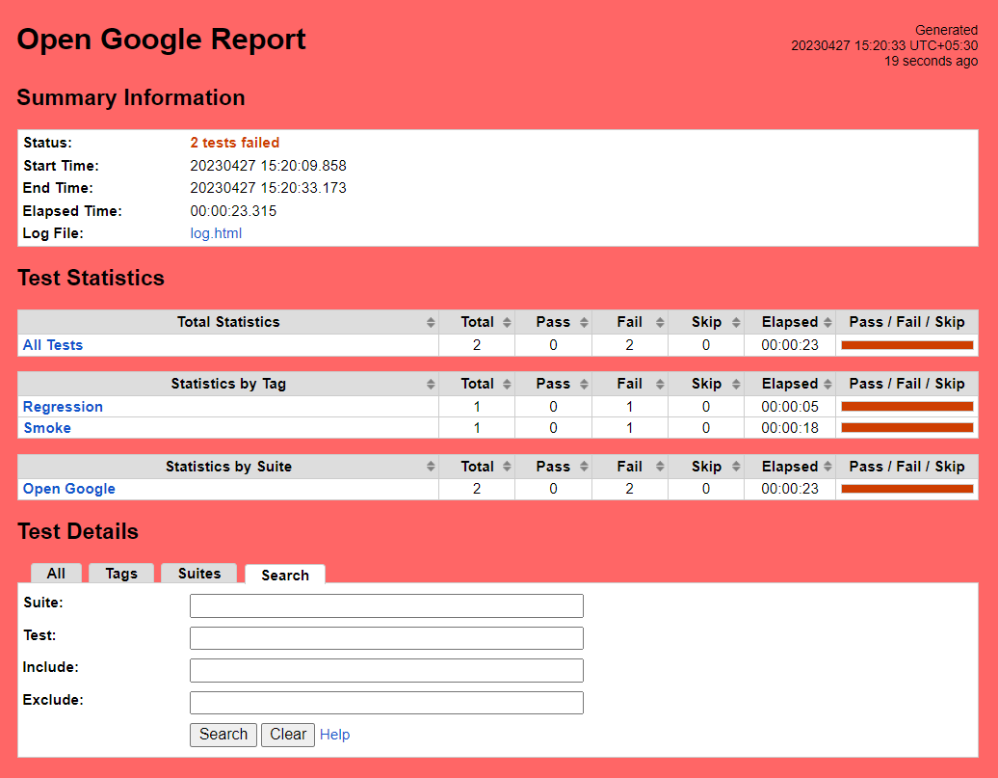
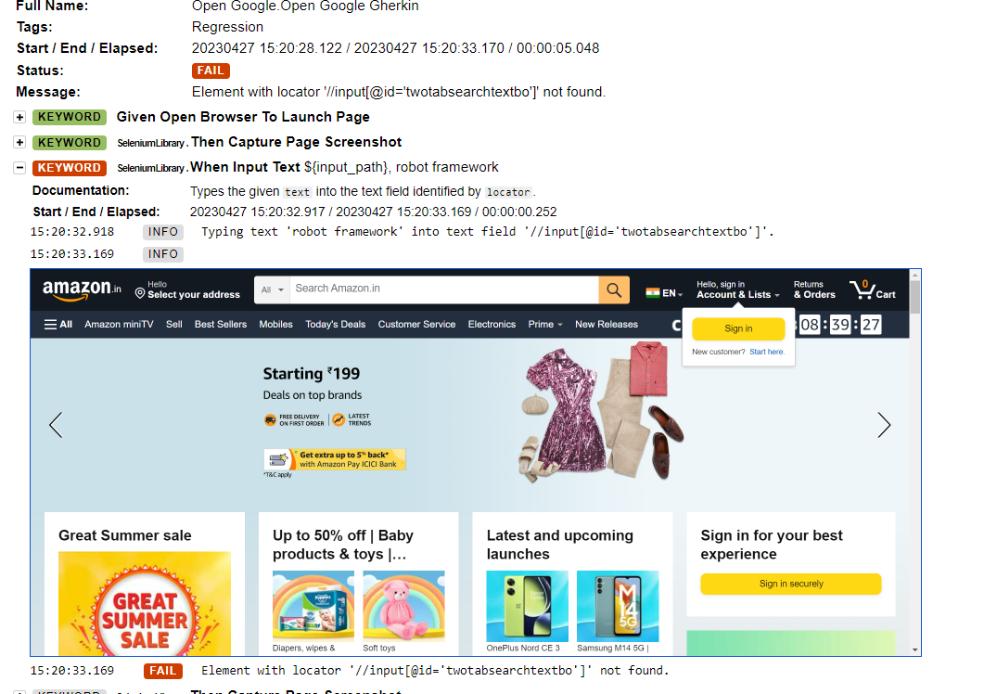
Contd…

Slide 14
Automation in nuuday
Legacy applications are currently automated in TOSCA.
Legacy As Is and New Stack applications are being automated using Robot Framework.
Framework is maintained in centralized Git repository.
Framework is integrated with Jenkins CICD tool in which the smoke and regression tests are run.

Slide 15
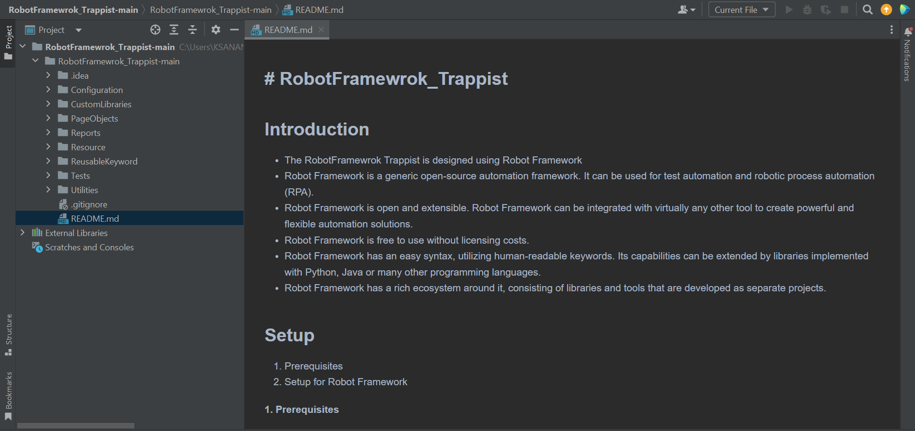
Robot Framework Trappist

Slide 16
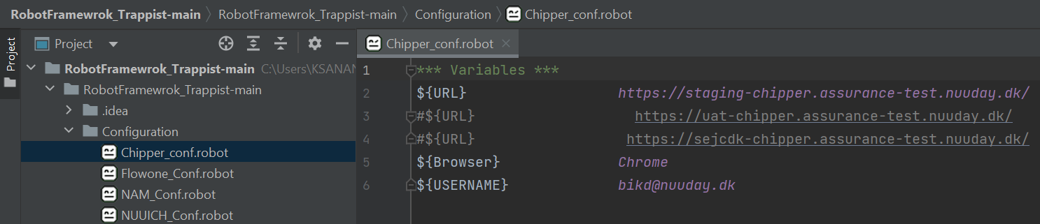
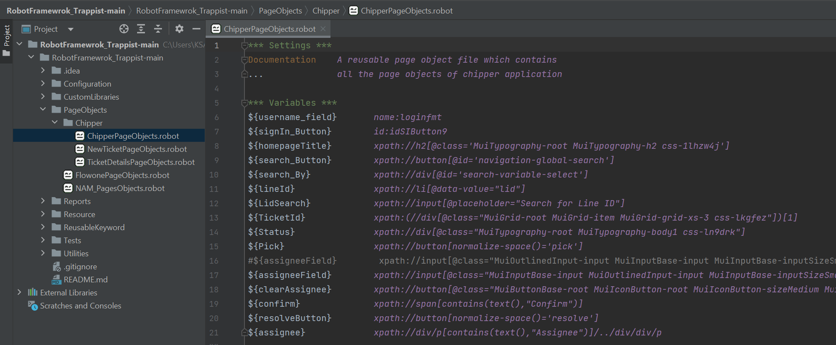

Slide 17
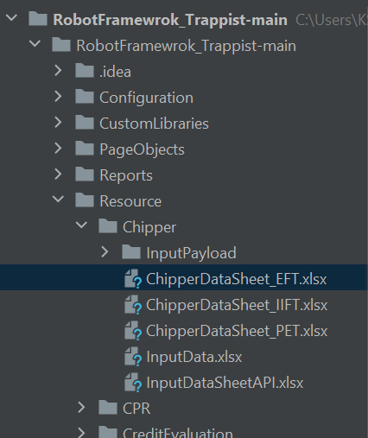
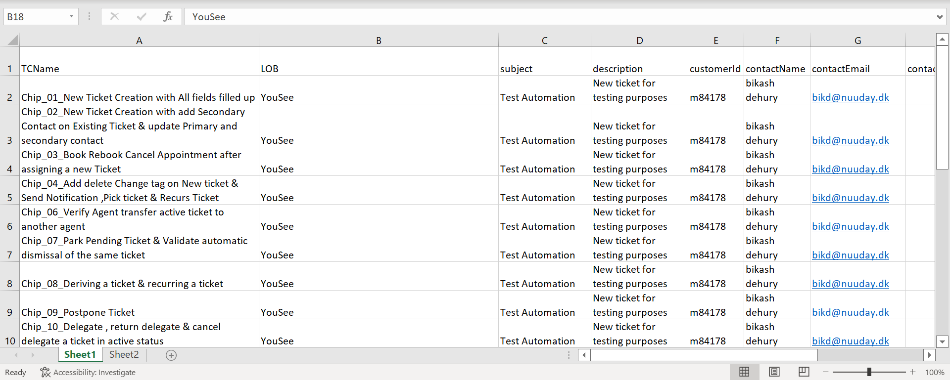

Slide 18
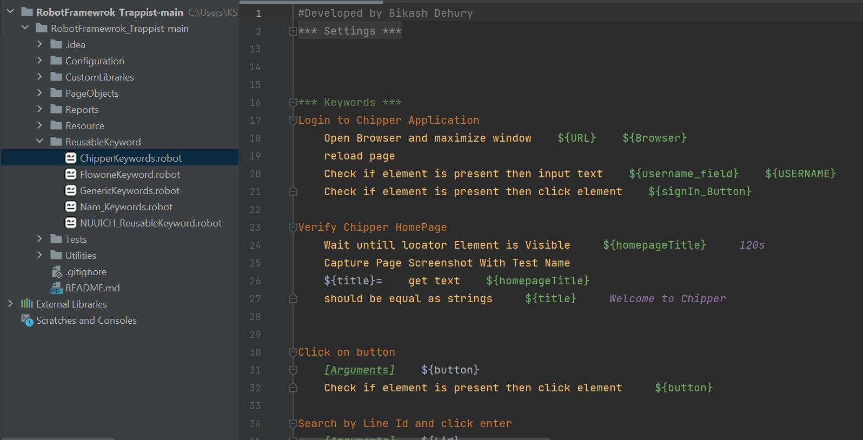
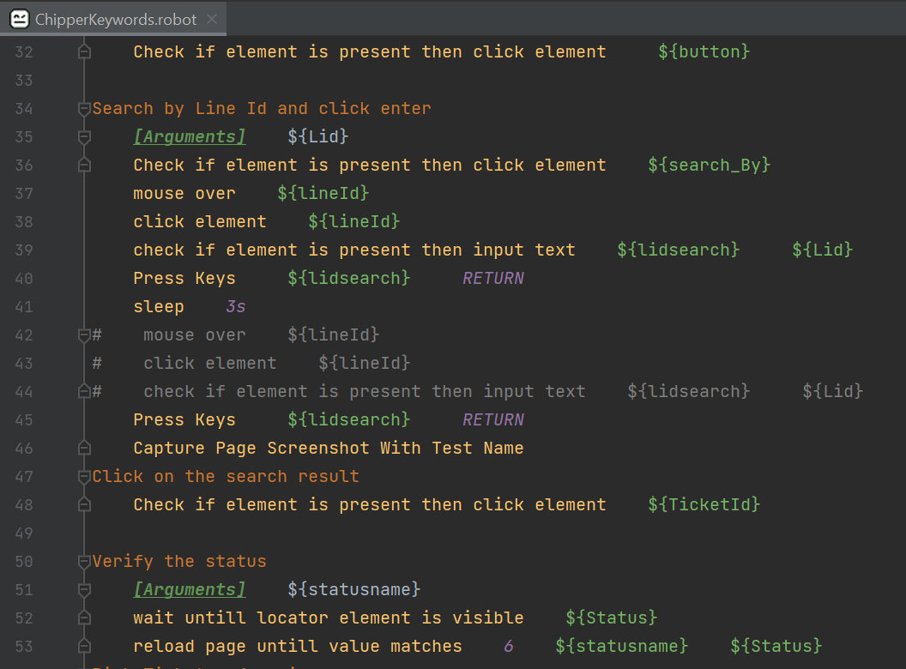
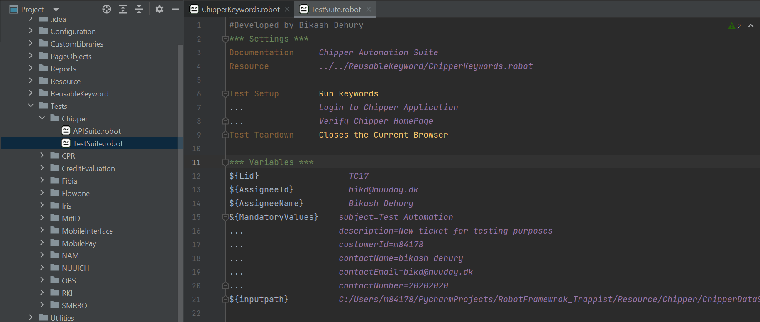

Slide 19
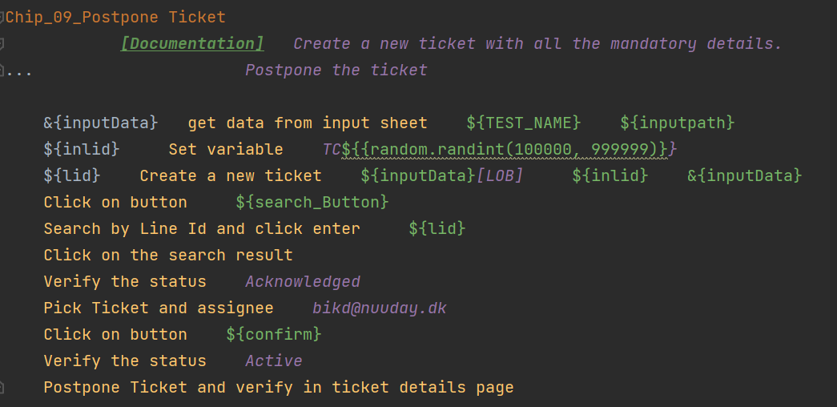

Slide 20
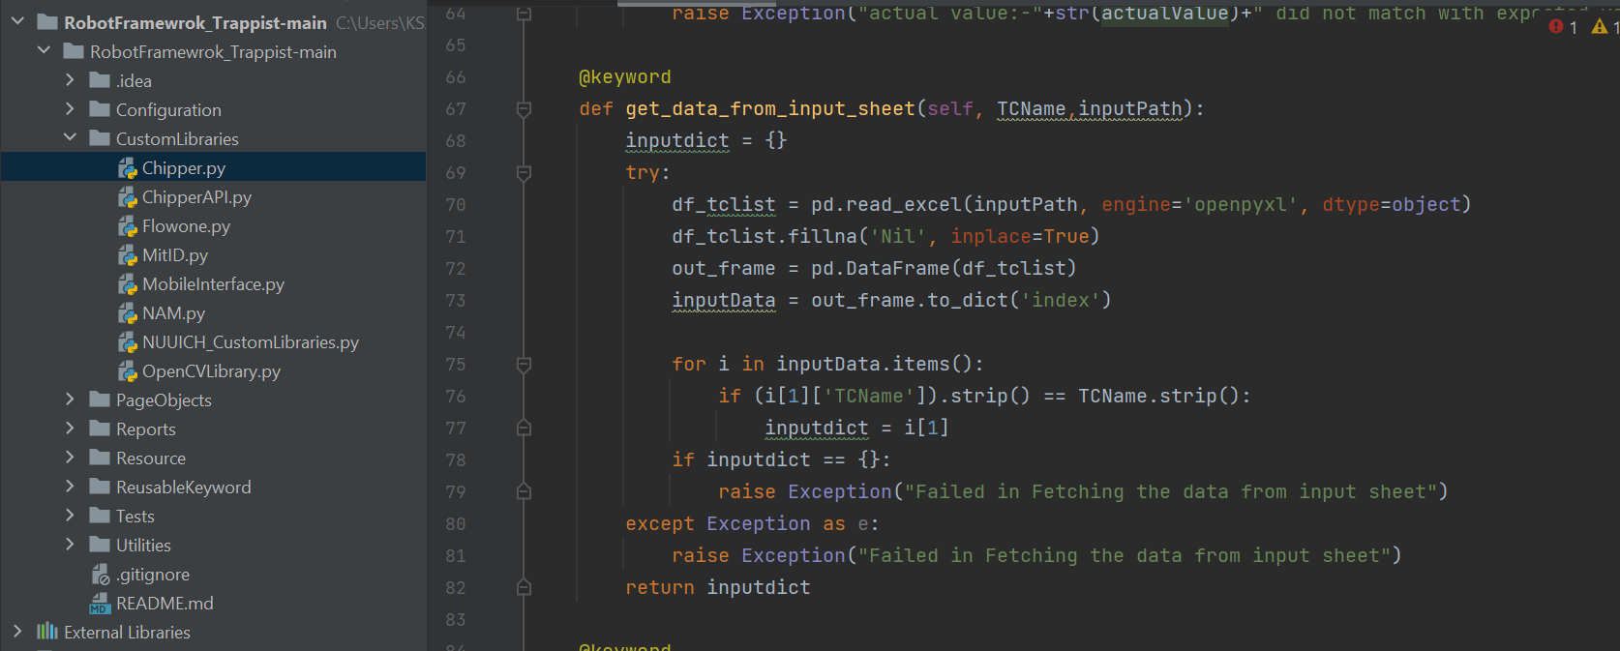

Slide 21
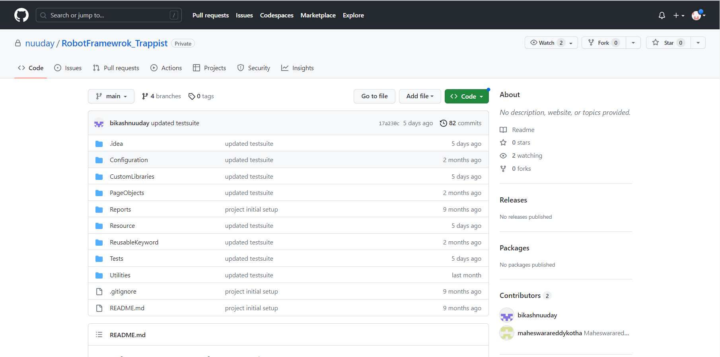
Git repository

Slide 22
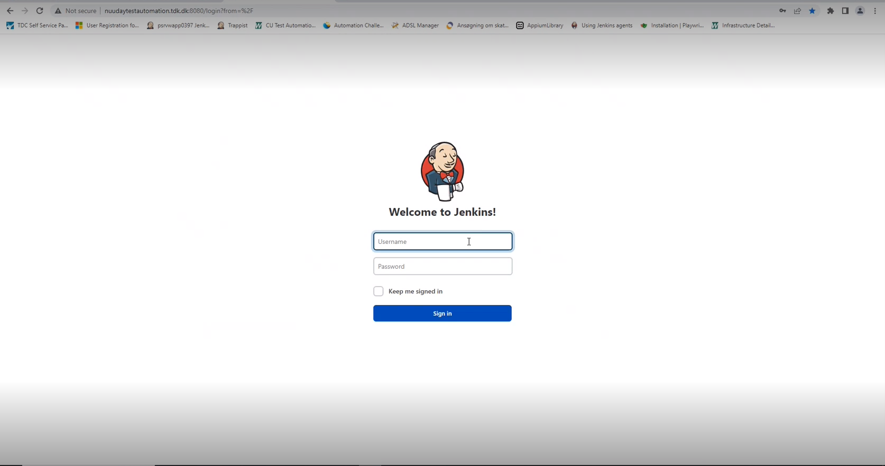
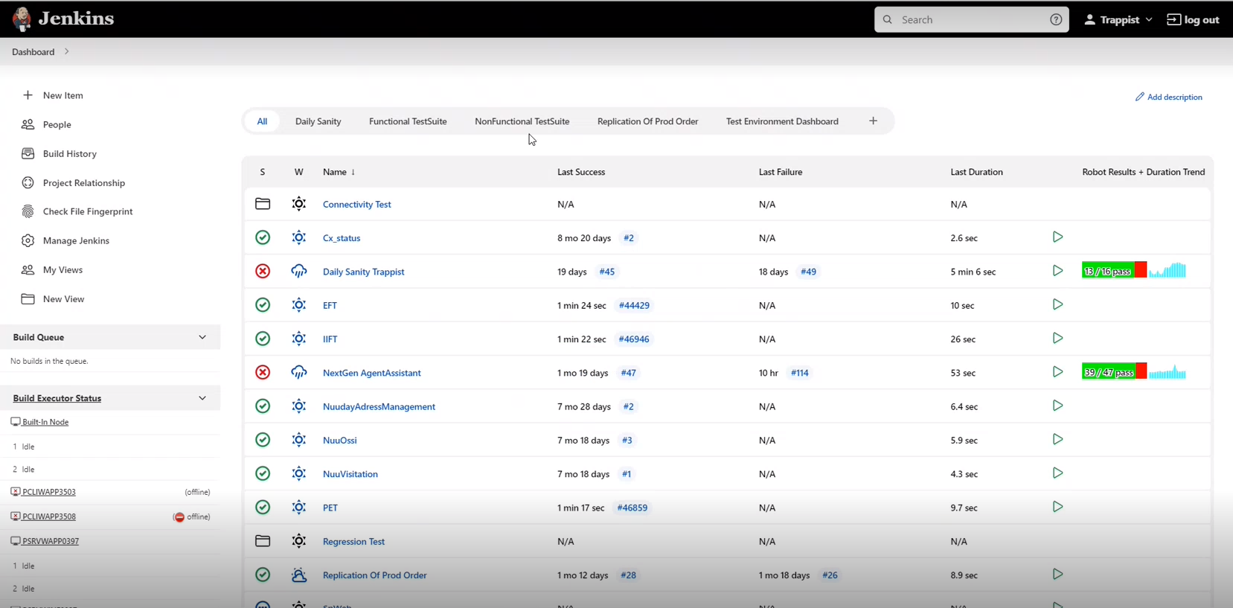
jenkins

Slide 23
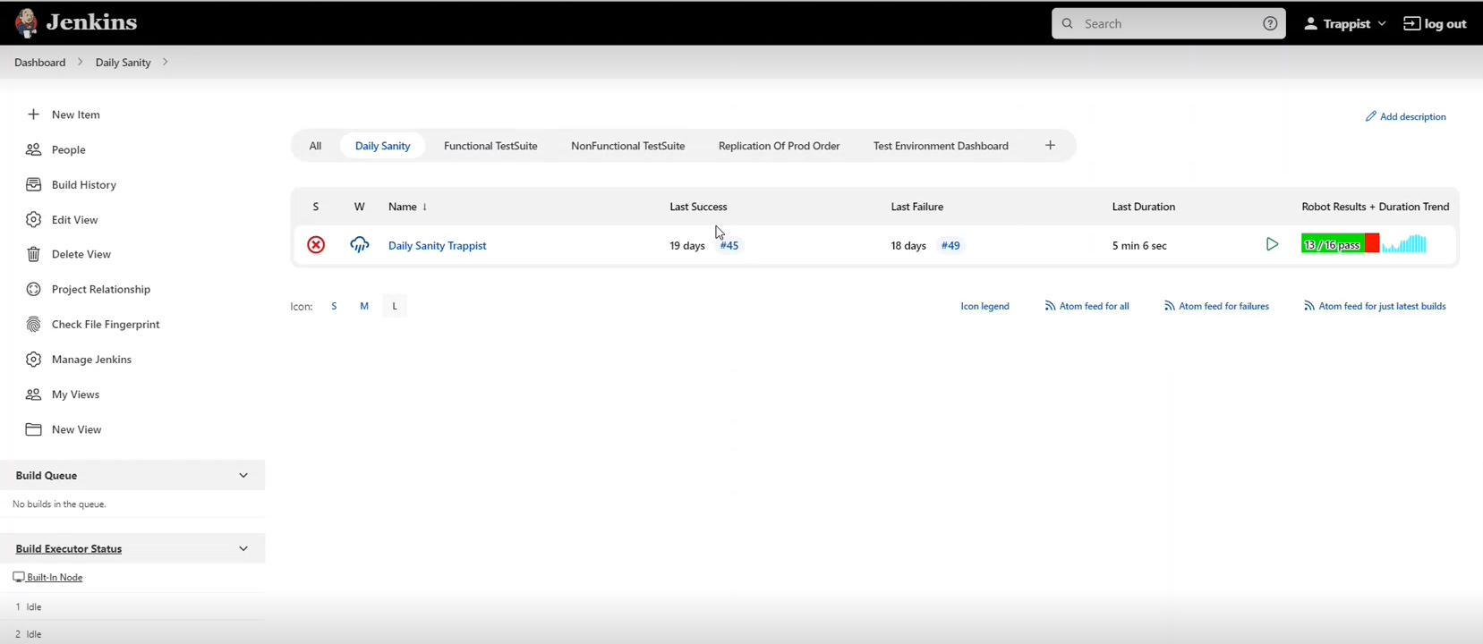
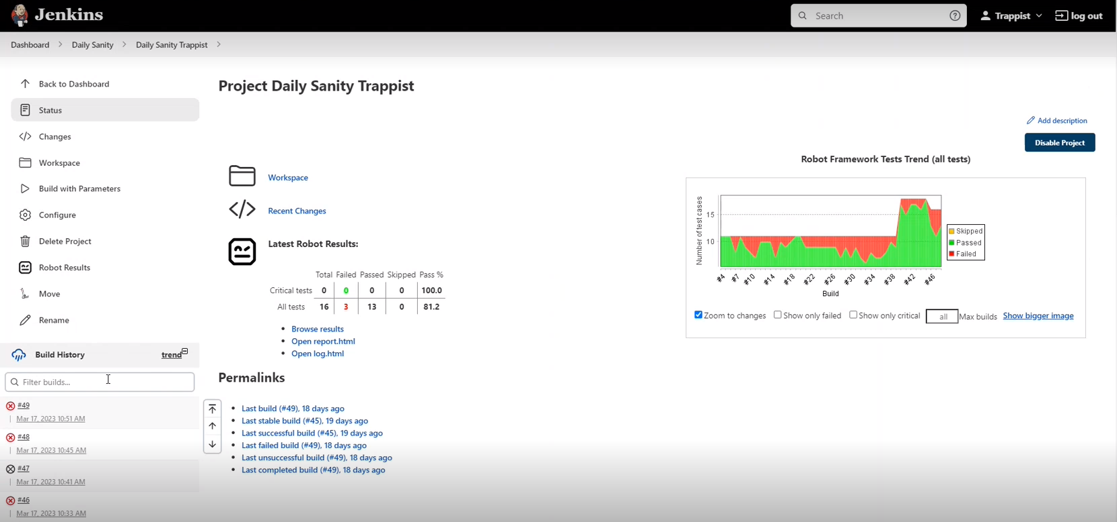

Slide 24
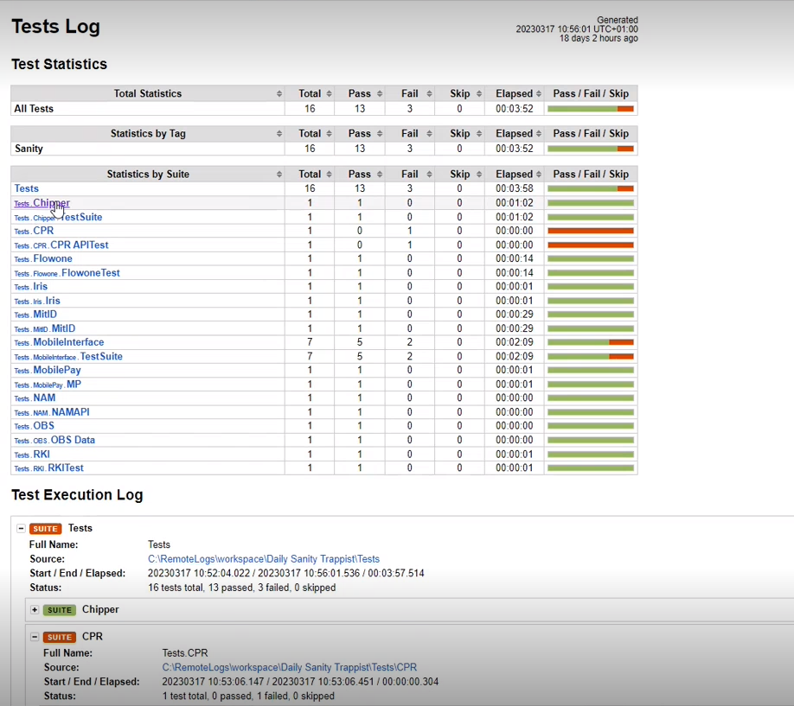
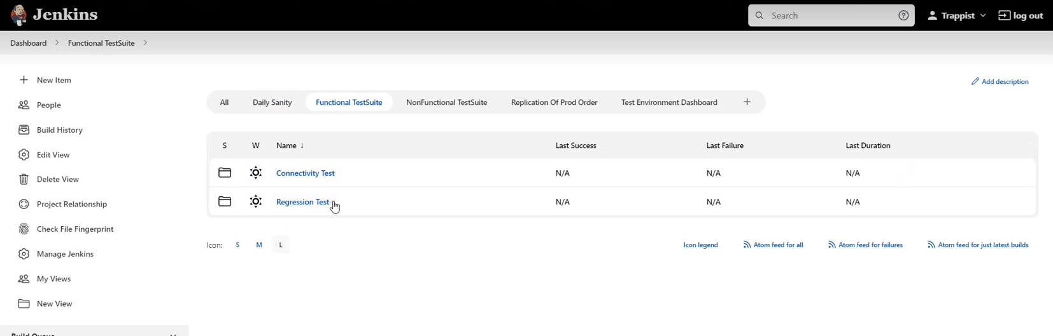

Slide 25
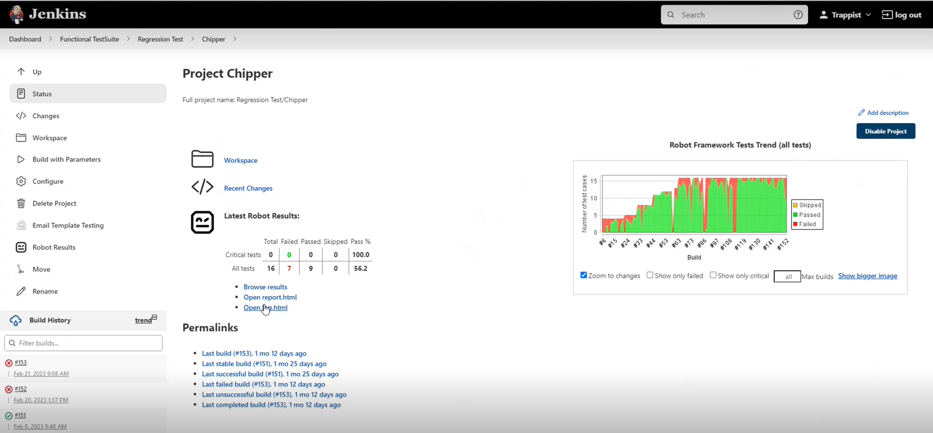
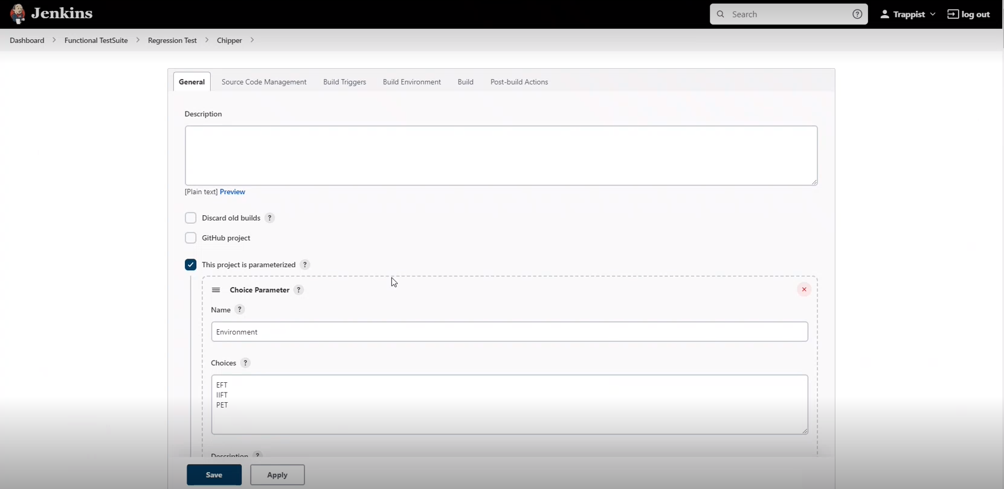

Slide 26
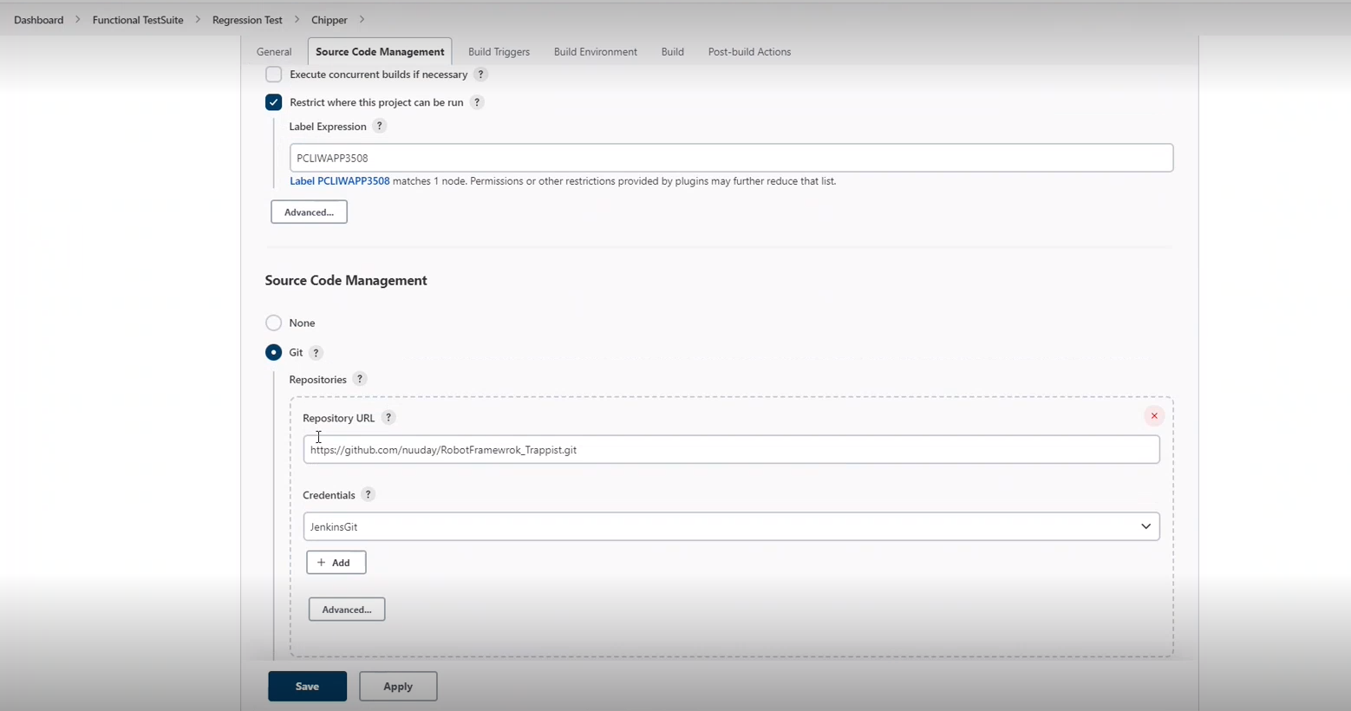
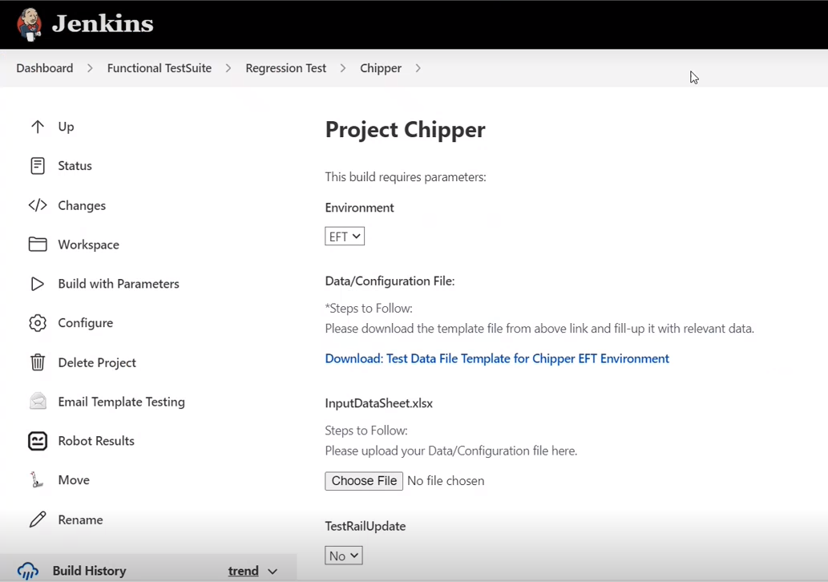

Slide 27
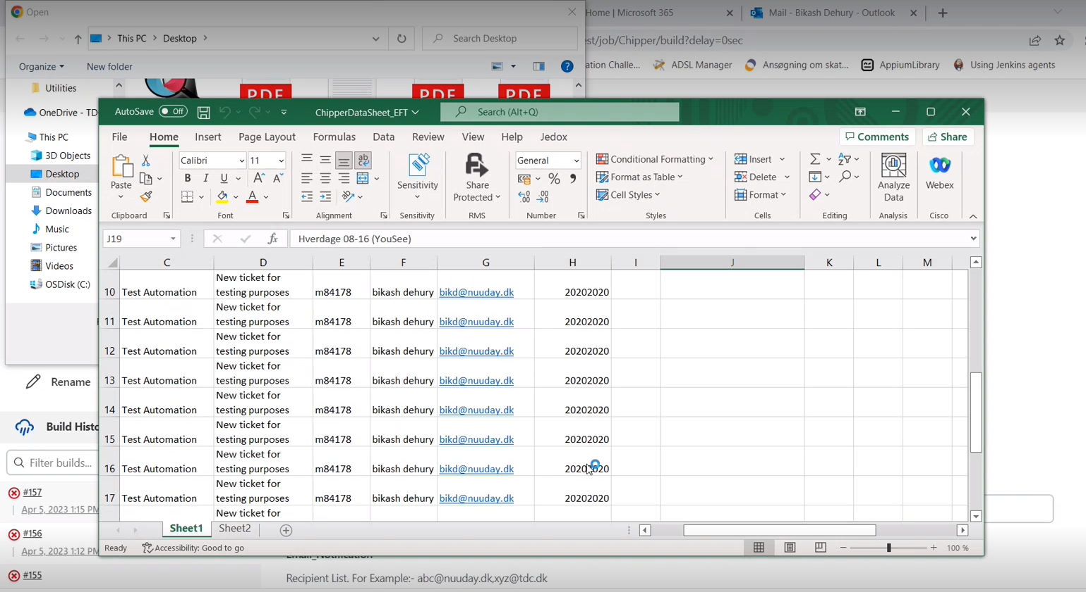
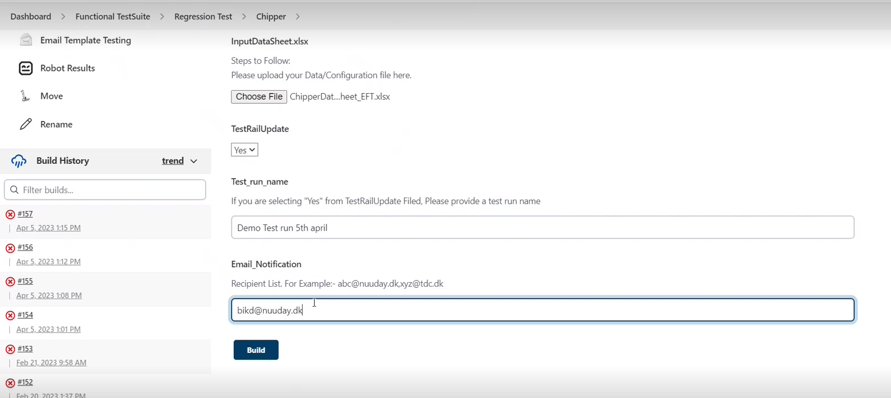

Slide 28
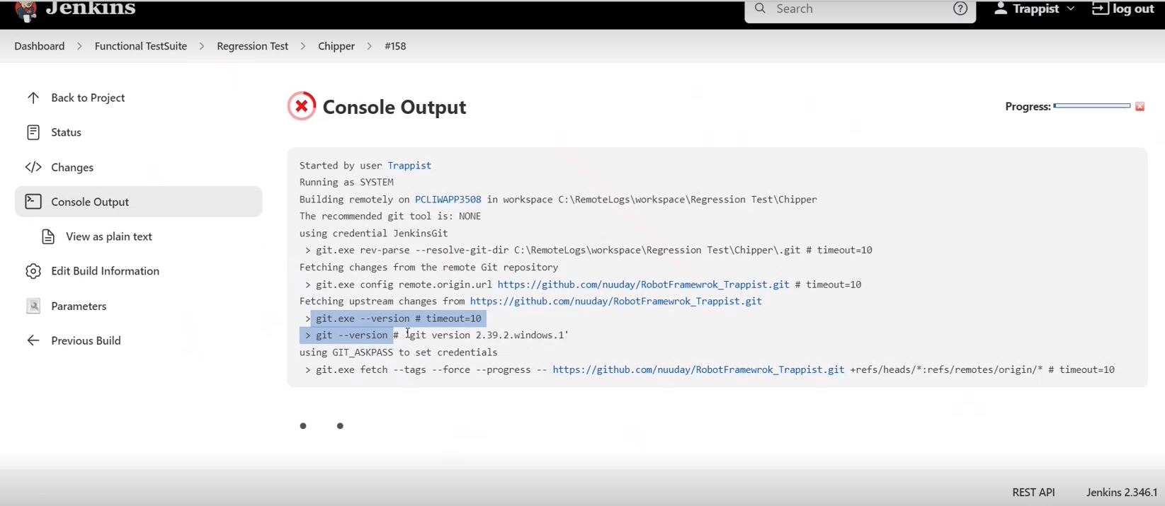
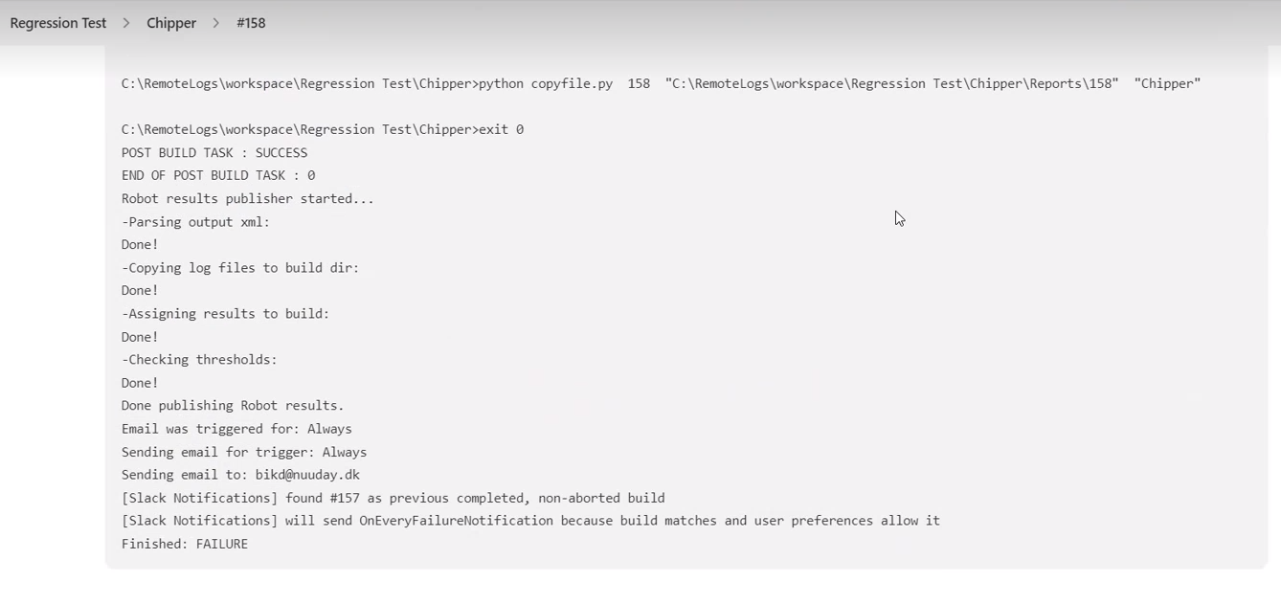

Slide 29
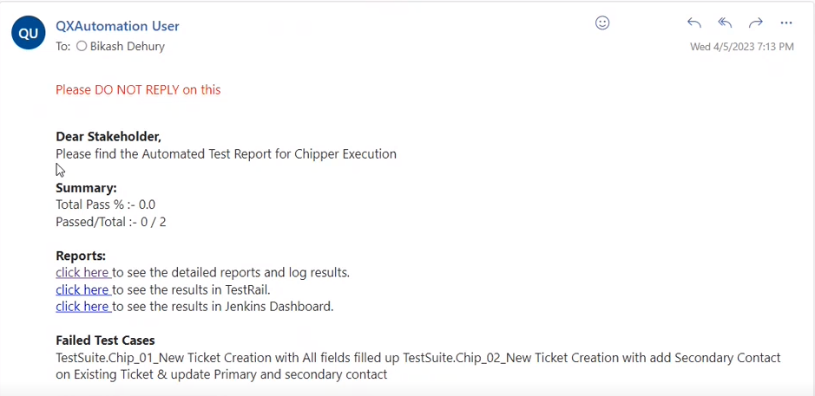
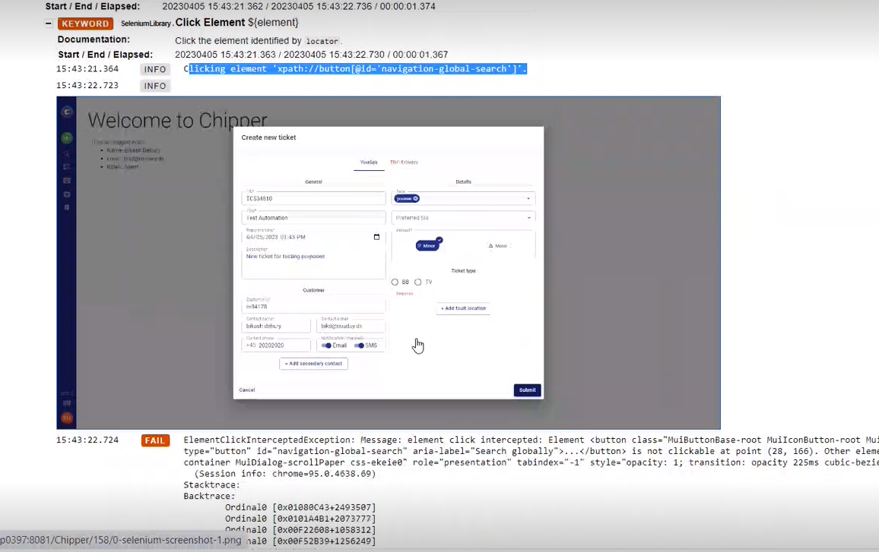

Slide 30
About Capgemini
Capgemini is a global leader in partnering with companies to transform and manage their business by harnessing the power of technology. The Group is guided everyday by its purpose of unleashing human energy through technology for an inclusive and sustainable future. It is a responsible and diverse organization of over 340,000 team members in more than 50 countries. With its strong 55-year heritage and deep industry expertise, Capgemini is trusted by its clients to address the entire breadth of their business needs, from strategy and design to operations, fueled by the fast evolving and innovative world of cloud, data, AI, connectivity, software, digital engineering and platforms. The Group reported in 2021 global revenues of €18 billion.
Get The Future You Want | www.capgemini.com

